Slide 1
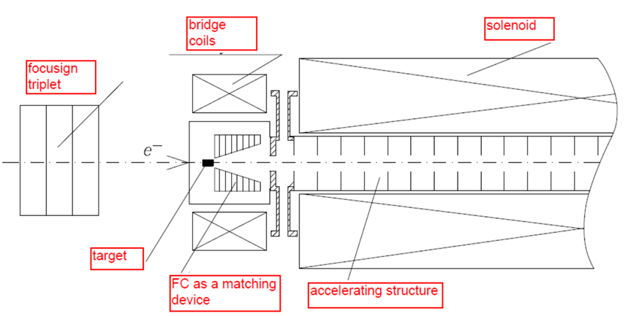
Схема позитронного источника

Slide 2
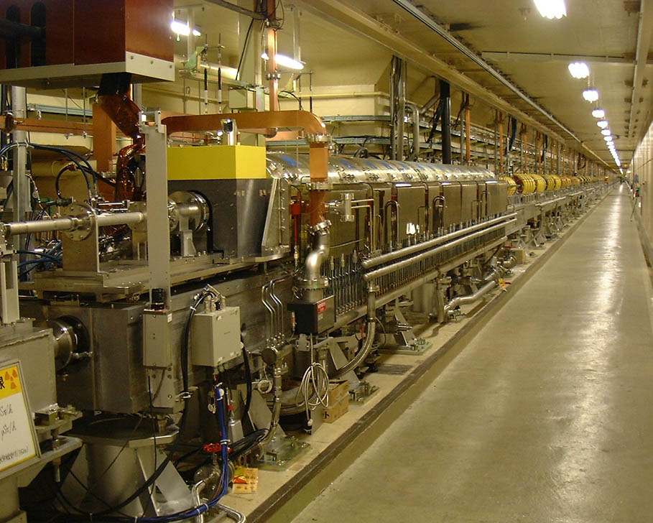
Positron source

Slide 3
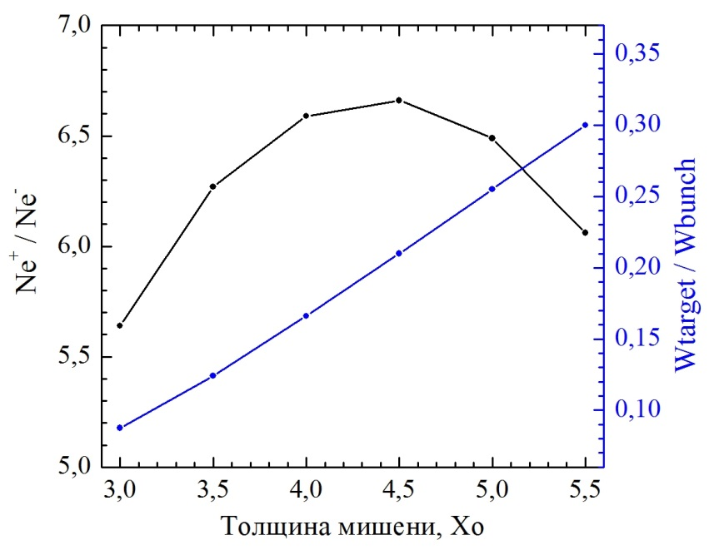
Число позитронов после мишени(слева),
общее энерговыделение в мишени (справа)
Энергия электронов 2.5 GeV
Мишень W74Re26 (возможно Тантал)
Радиационная длина X_{O} = 3.5 мм
Средняя мощность энерговыделения в мишени 2×100 W
число е- 5×10¹⁰
толщина мишени 4.5X_{O}
частота повторения 25 Гц

Slide 4
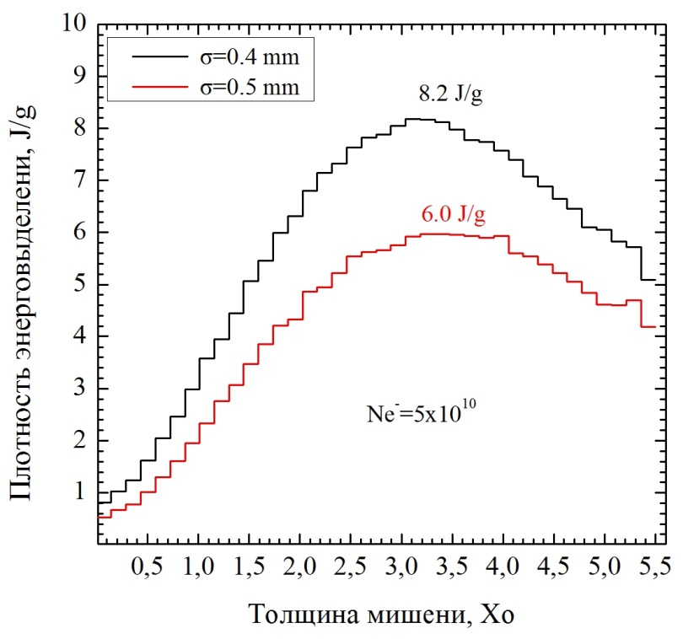
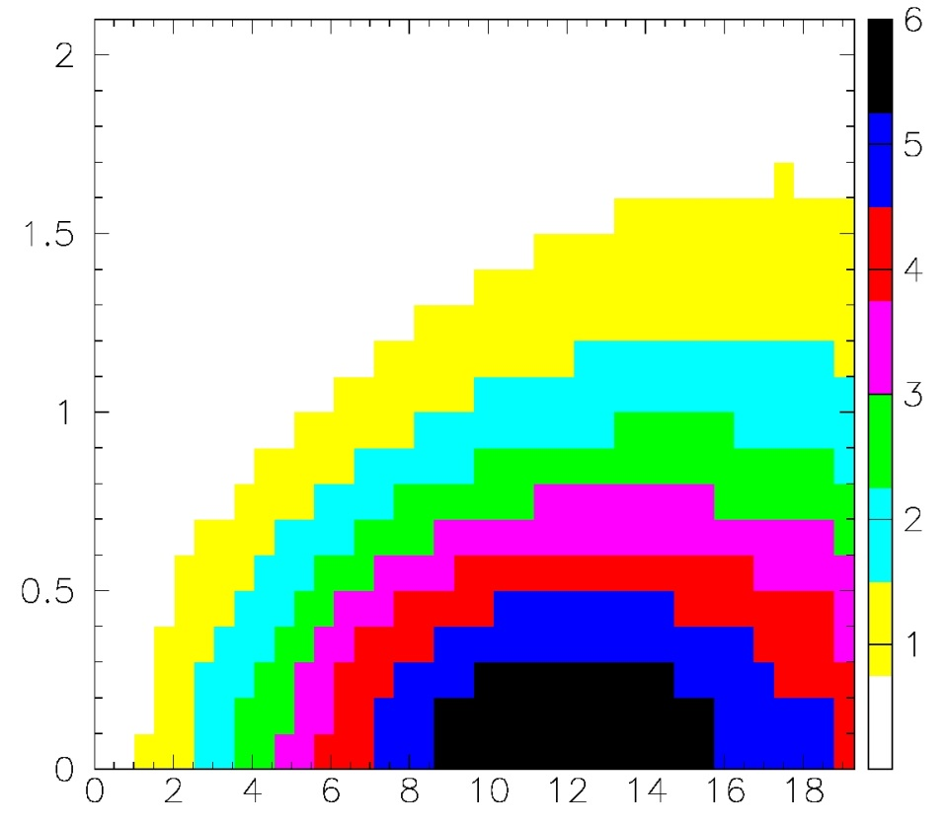
Плотность энерговыделения от одного сгустка электронов
Пороговая плотность энерговыделения в W74Re26 35J/g (SLAC)
Плотность энерговыделения оси , J/g
Плотность энерговыделения, J/g
Область максимального энерговыделения (90%÷100%)
2.5÷4.5X_{O} по глубине
0.3 мм по радиусу
σ_{R}≈1.2 мм
Радиус, мм
Толщина мишени, мм

Slide 5
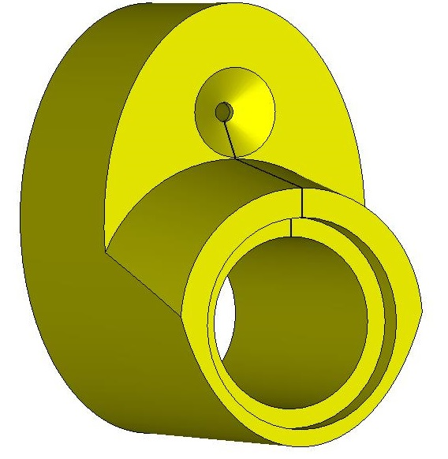
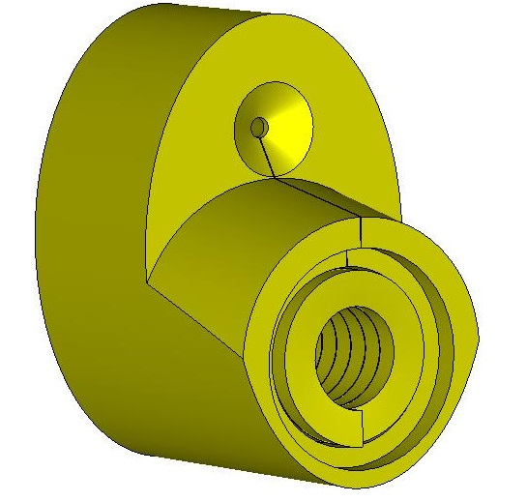
cτ Flux Concentrator (FC) computer model
Elliptical cylinder 120x180 mm
Total length is140 mm
Conical part length is 70 mm
Min cone diameter is 8 mm
Max cone diameter is 44 mm
Cone angle is ≈30 degrees
Cylindrical hole diameter is 70 mm
Coil has 13 turns
Current profile is a half of sine with a pulse length of 25 µs
Gap between coil turns is 0.4 mm
Gap between coil and FC body is 1 mm
Turns size is 9.6x14 mm

Slide 6
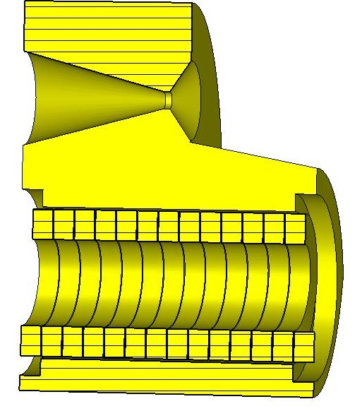
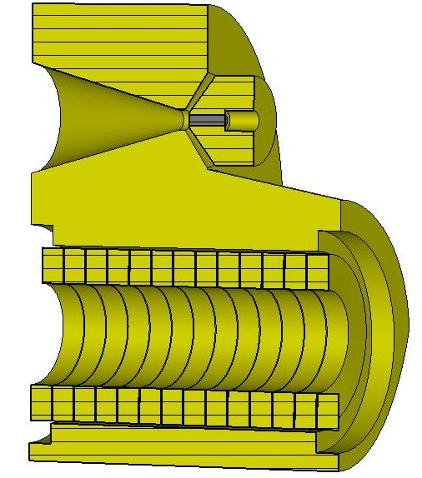
Elliptical cylinder 120x180 mm
Total length is140 mm
Conical part length is 70 mm
Min cone diameter is 8 mm
Max cone diameter is 44 mm
Cone angle is ≈30 degrees
Cylindrical hole diameter is 70 mm
Coil has 13 turns
Current profile is a half of sine with a pulse length of 25 µs
Gap between coil turns is 0.4 mm
Gap between coil and FC body is 1 mm
Turns size is 9.6x14 mm
Target rod (W74Re26) diameter is 4 mm, length is 15.7 mm
External target unit diameter is 35 mm

Slide 7
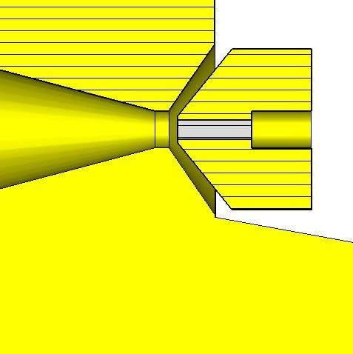
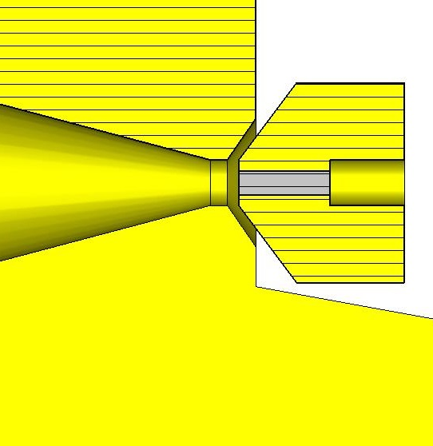
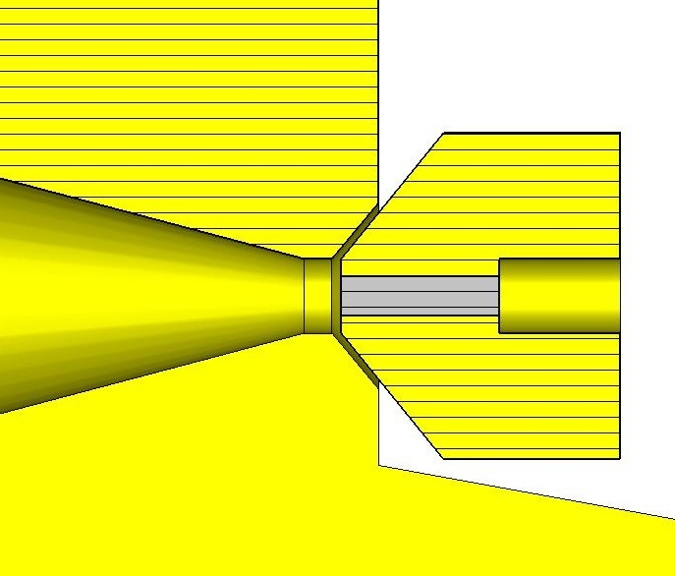
Modifications of target position and FC front face
Min cone diameter is 8 mm
0 position
Model 1.
Target position of end face
is -2mm
Model 2. Modification of FC front face around of a target
Model 3. Modification of gap between FC front face and target
Target position of end face is -1mm

Slide 8
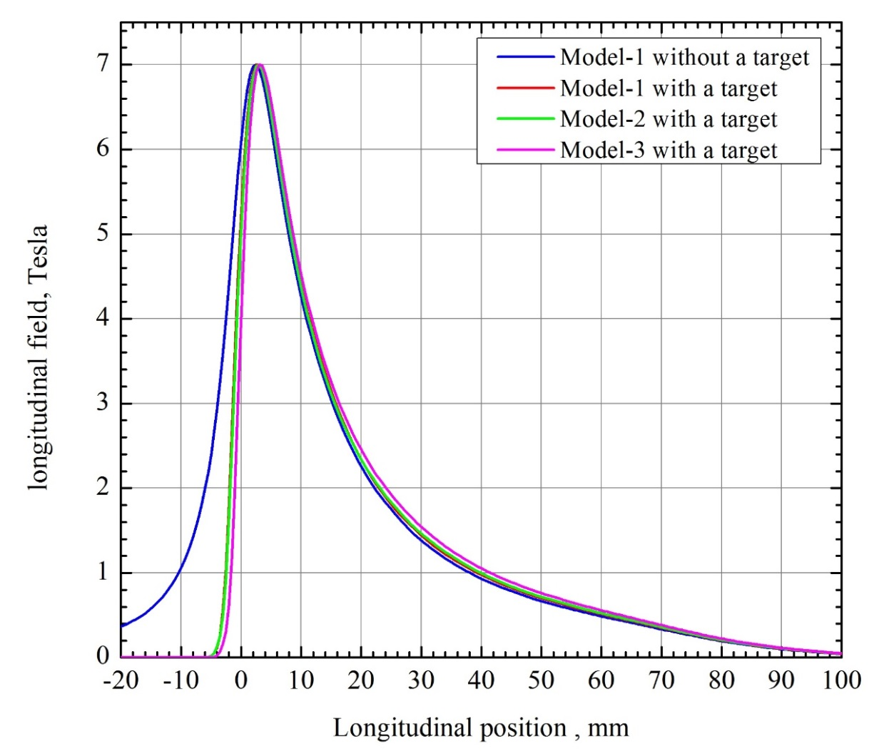
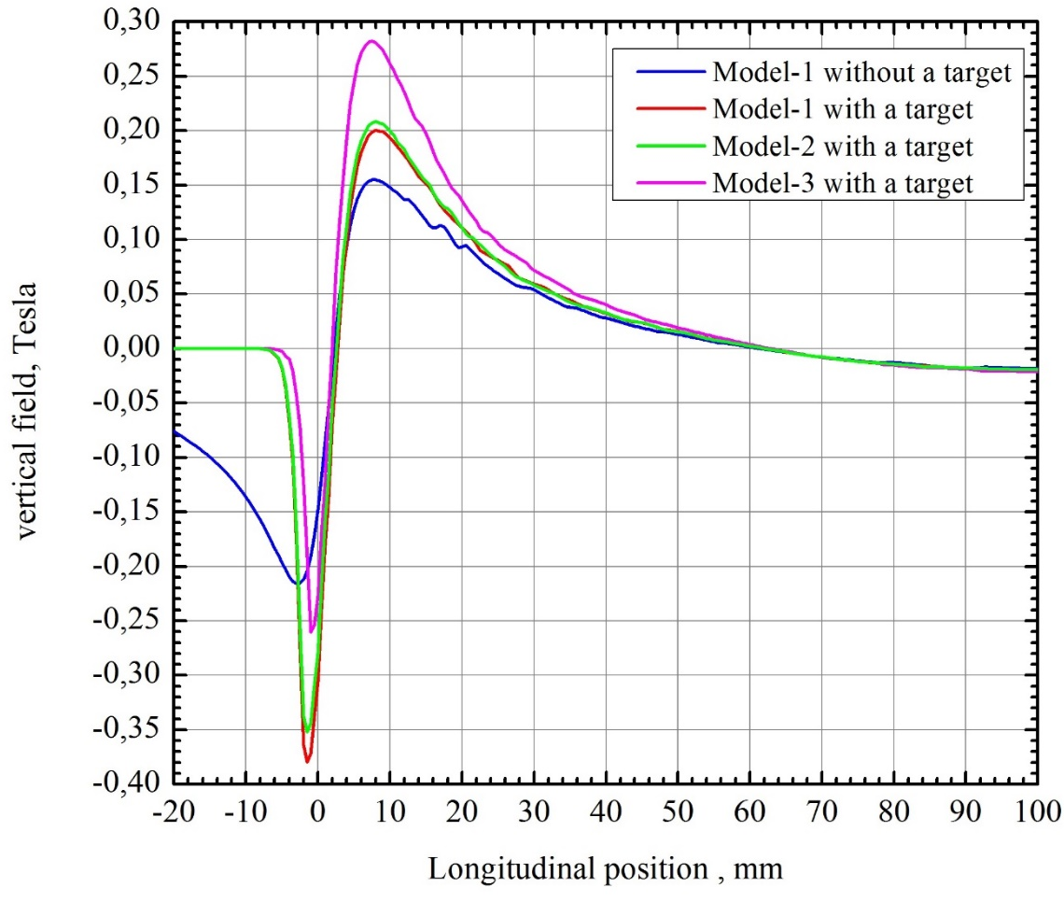
Longitudinal magnetic field component on axis of Flux Concentrator. Peak field position is 3 mm
Transverse magnetic field components on axis of Flux Concentrator

Slide 9
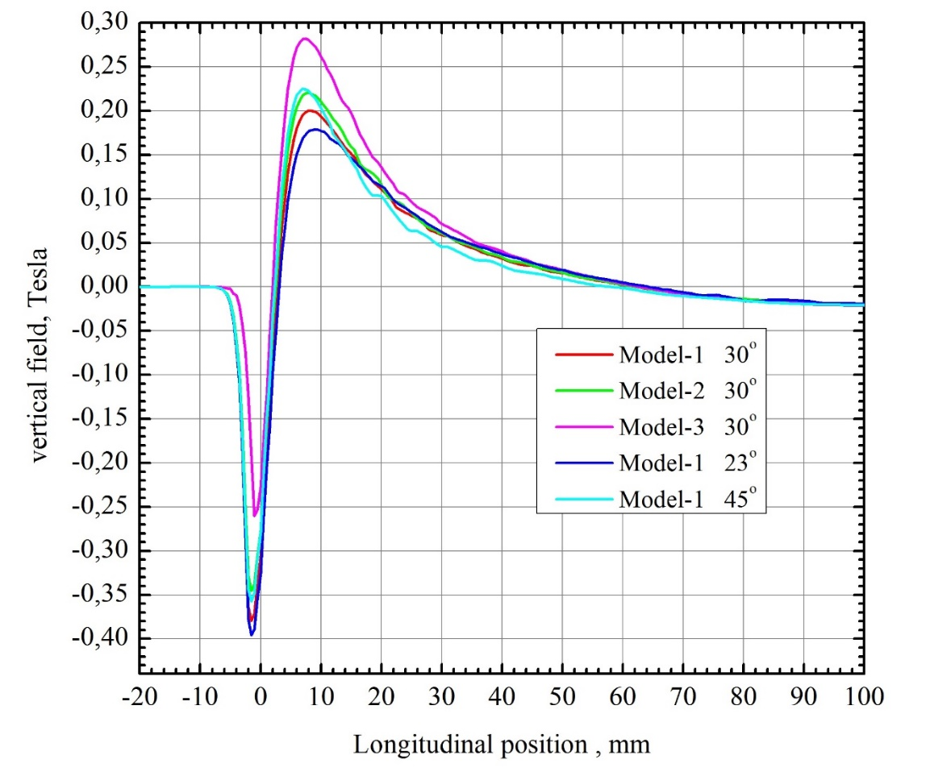
Transverse magnetic field components on axis of Flux Concentrator
Peak field position is 8 mm
Cone angle is 30^{O}
Cone angle modification with 23^{O} and 45^{O}

Slide 10
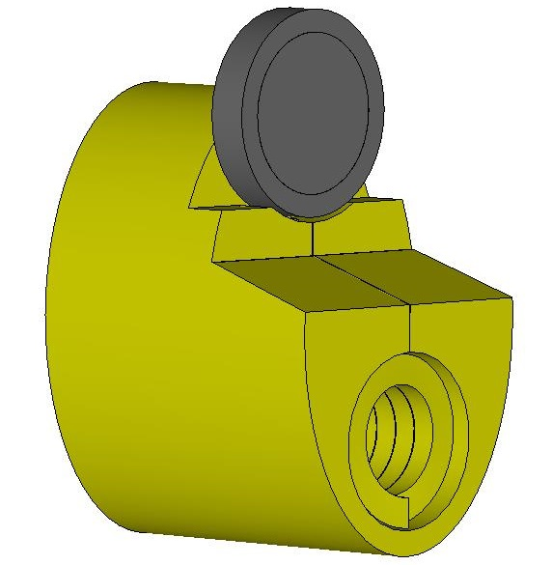
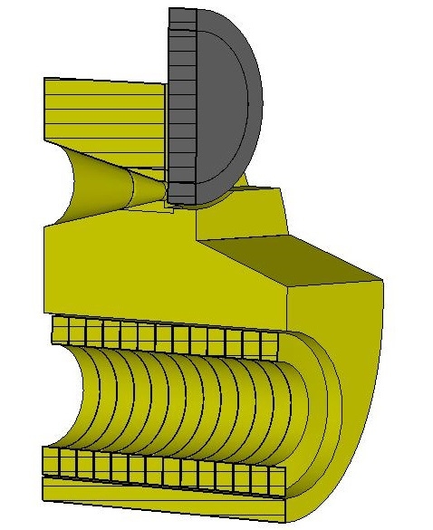
FCC-ee FC Computer model with a positron production target
Elliptical cylinder 120x180 mm
Total length is140 mm
Conical part length is 70 mm
Min cone diameter is 8 mm
Max cone diameter is 44 mm
Cone angle is ≈29 degrees
Cylindrical hole diameter is 70 mm
Coil has 13 turns
Current profile is a half of sine with a pulse length of 25 µs
Peak current is ~ 20 kA (peak field is 7 Tesla)
Gap between coil turns is 0.4 mm
Gap between coil and FC body is 1 mm
Turns size is 9.6x14 mm
Target (W74Re26) diameter is 90 mm, thickness is 15.7 mm
Gap between target and FC front face is 2mm

Slide 11
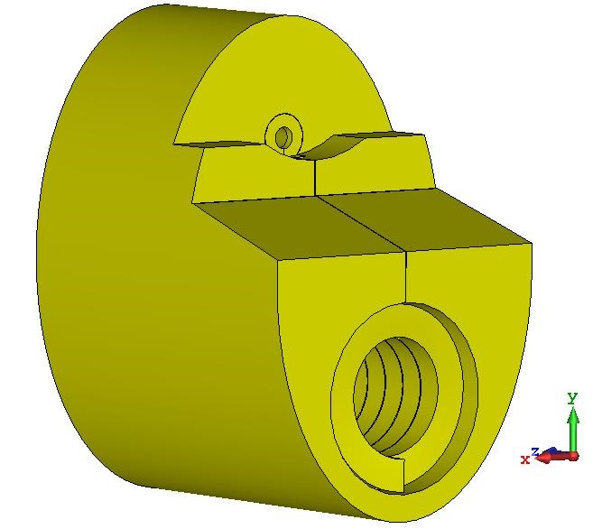
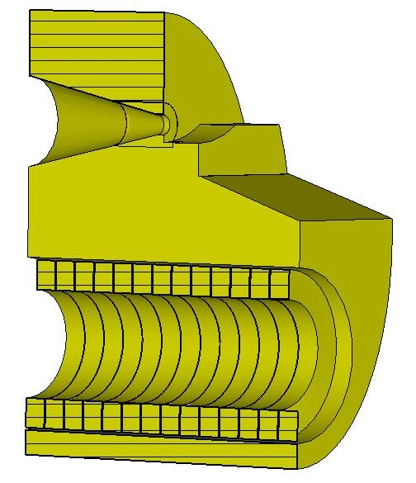
FCC-ee FC Computer model with a positron production target
Elliptical cylinder 120x180 mm
Total length is140 mm
Conical part length is 70 mm
Min cone diameter is 8 mm
Max cone diameter is 44 mm
Cone angle is ≈29 degrees
Cylindrical hole diameter is 70 mm
Coil has 13 turns
Current profile is a half of sine with a pulse length of 25 µs
Peak current is ~ 20 kA (peak field is 7 Tesla)
Gap between coil turns is 0.4 mm
Gap between coil and FC body is 1 mm
Turns size is 9.6x14 mm
Target (W74Re26) diameter is 90 mm, thickness is 15.7 mm
Gap between target and FC front face is 2mm

Slide 12
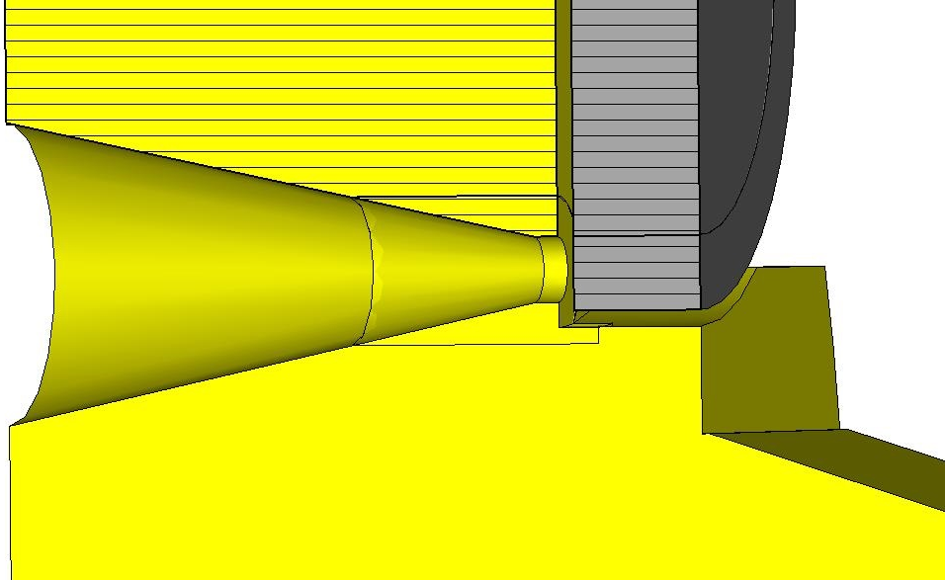
Geometry Variations of
FCC-ee FC Computer model
‘0’ position
Model #1 grooving gap is 2 mm, gap between FC front face and target is 2 mm
Model #2 grooving gap is 2 mm, gap between FC front face and target is 3 mm
Model #3 grooving gap is 2 mm, gap between FC front face and target is 4 mm
Model #4 grooving gap is 3 mm, gap between FC front face and target is 4 mm
Model #5 grooving gap is 4 mm, gap between FC front face and target is 4 mm

Slide 13
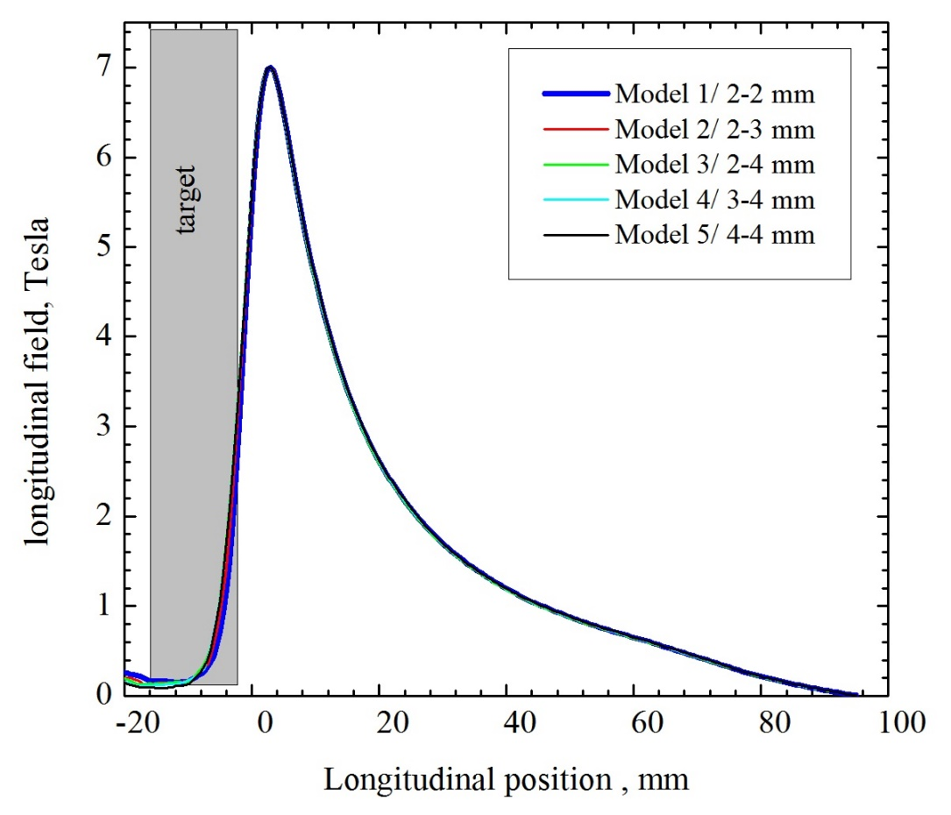
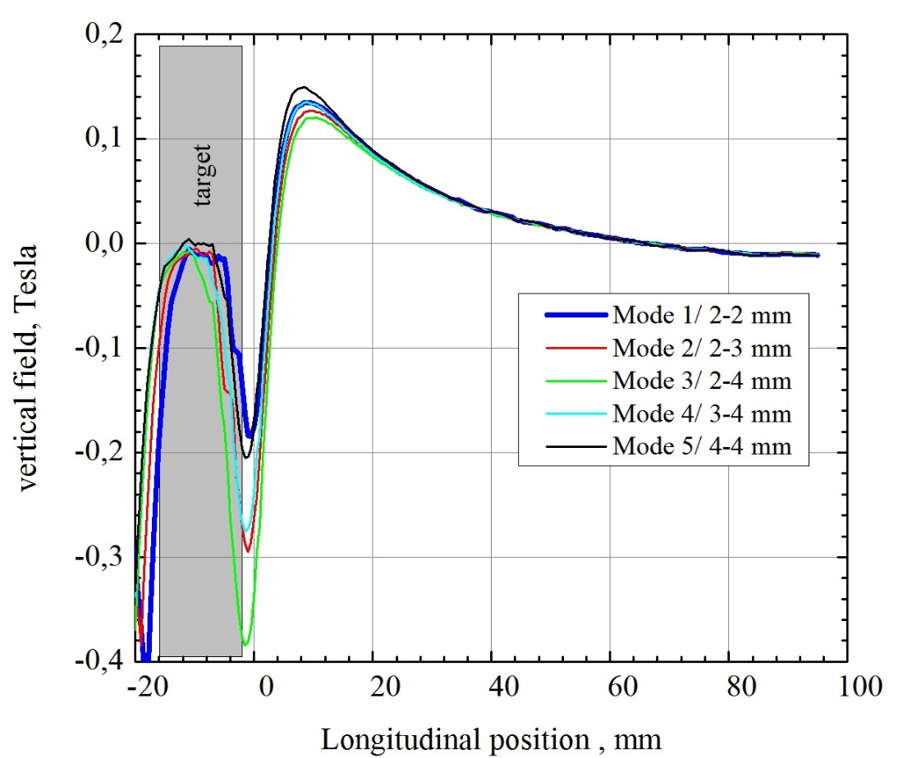
Field profiles on FC axis
Model #1 grooving gap is 2 mm, gap between FC front face and target is 2 mm
Model #2 grooving gap is 2 mm, gap between FC front face and target is 3 mm
Model #3 grooving gap is 2 mm, gap between FC front face and target is 4 mm
Model #4 grooving gap is 3 mm, gap between FC front face and target is 4 mm
Model #5 grooving gap is 4 mm, gap between FC front face and target is 4 mm

Slide 14
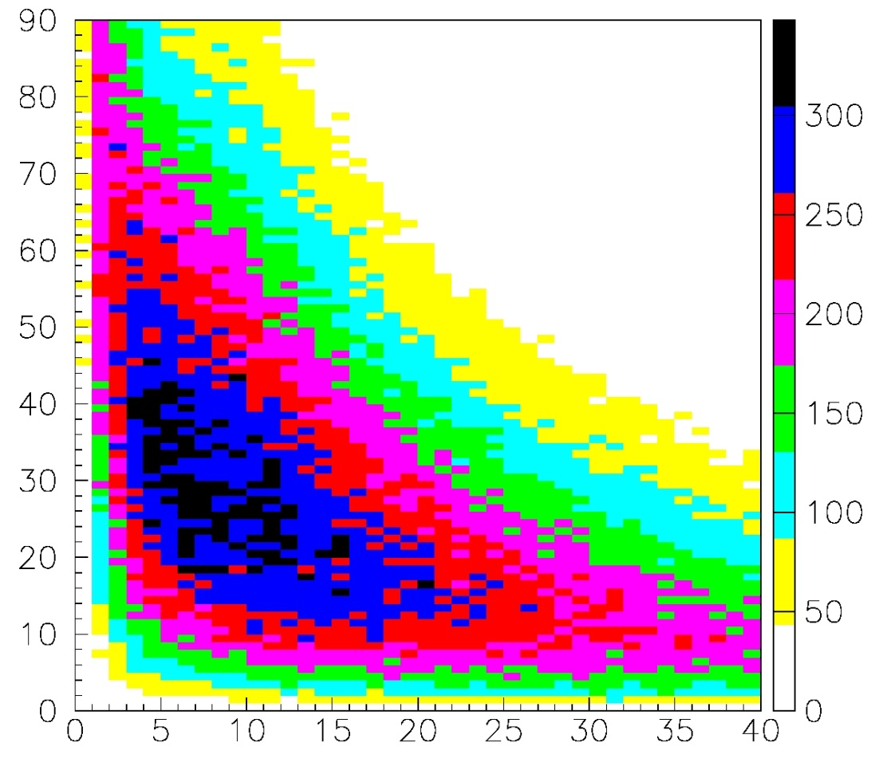
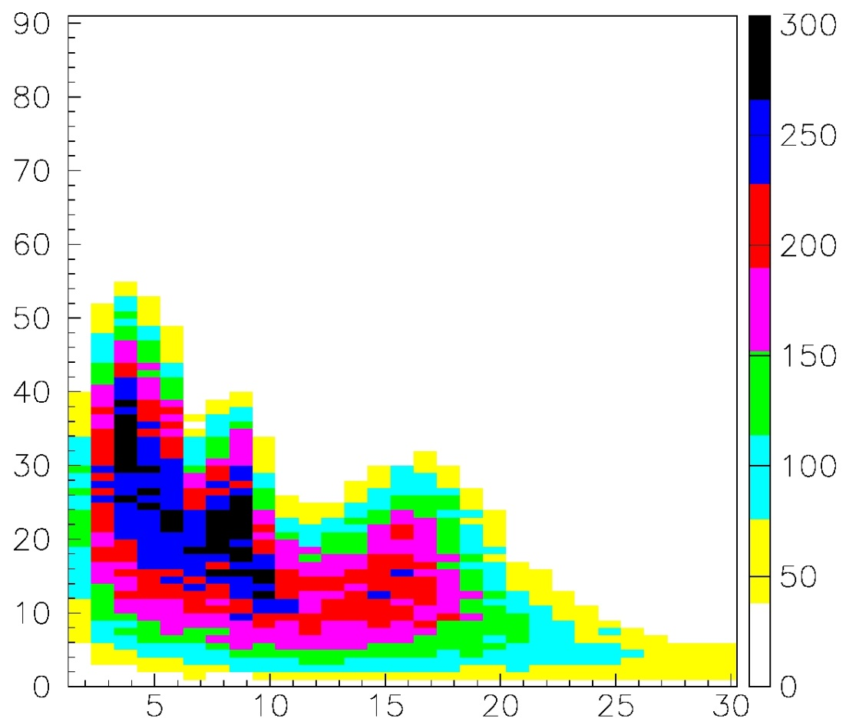
Энергетически-угловое распределение позитронов после мишени
Энергетически-угловое распределение позитронов после мишени (захват)
Угол, градусы
Угол, градусы
Энергия, MeV
Энергия, MeV

Slide 15
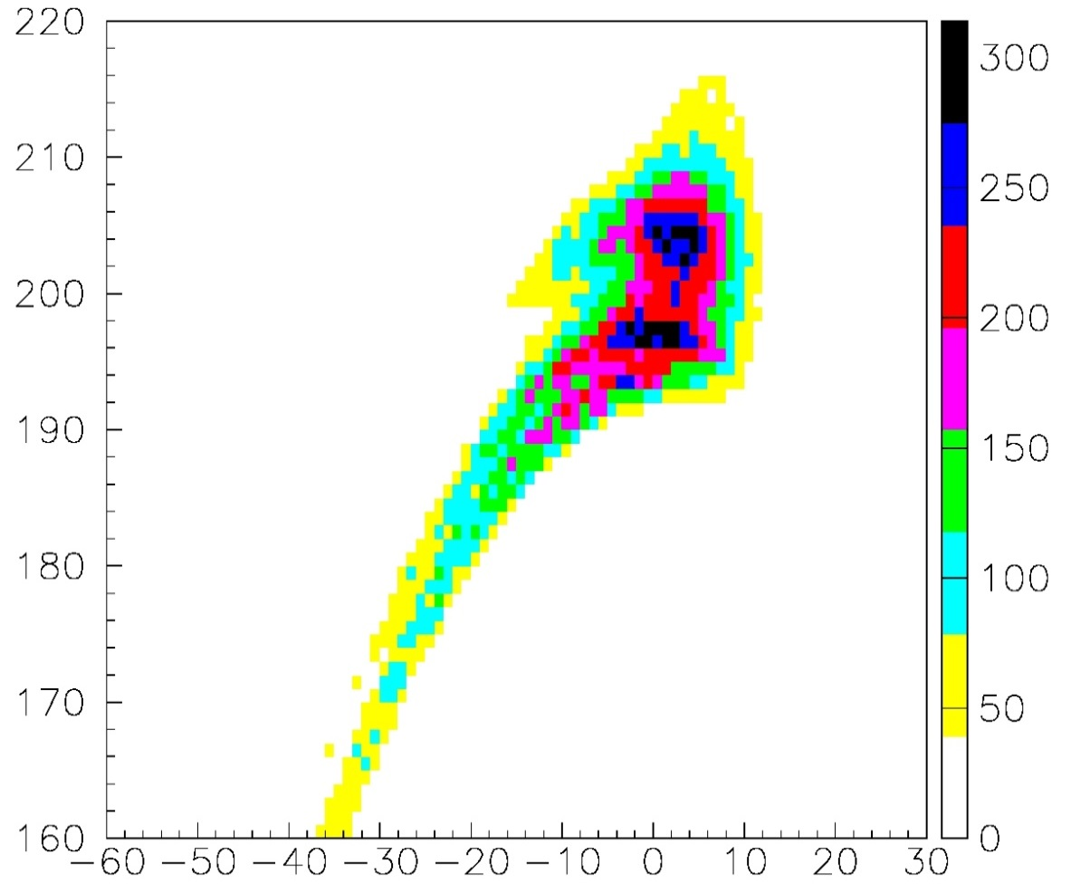
Фазово-энергетическое распределение сгустка позитронов после соленоида
Поперечный размер e- (σ) 0.5 мм
Продольный размер e- (σ) 1.0 мм
Энергия, MeV
Фазовая длина сгустка, градусы

Slide 16
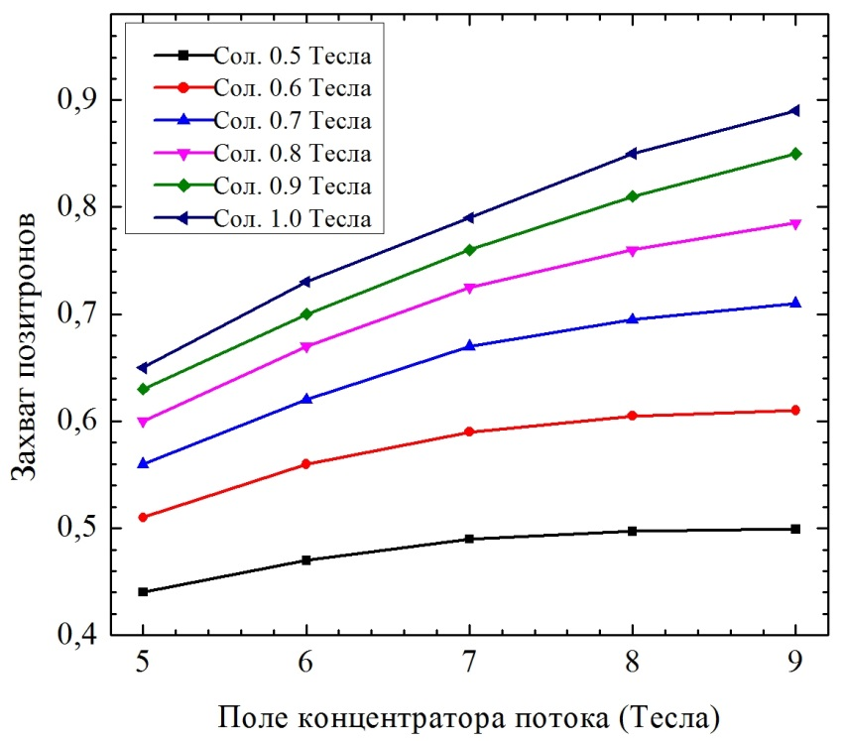
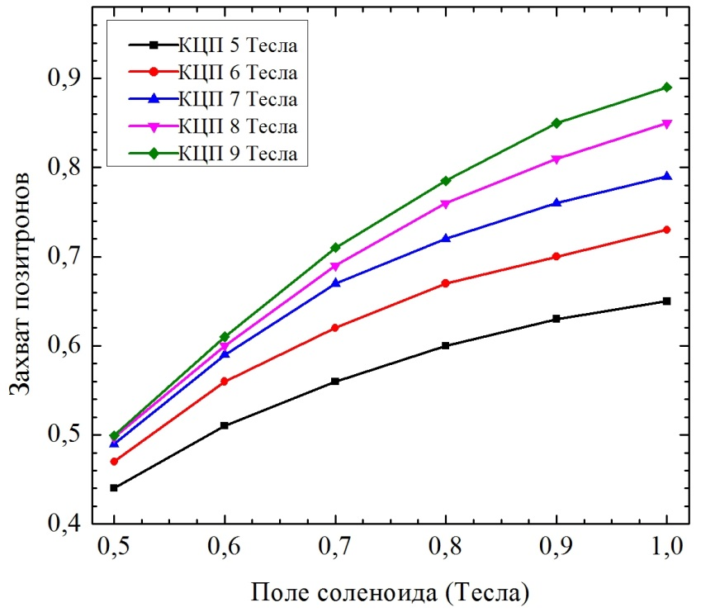
Оценочный захват позитронов ( e+ энергия ~200 MeV после соленоида)
Диаметр структуры 24мм

Slide 17
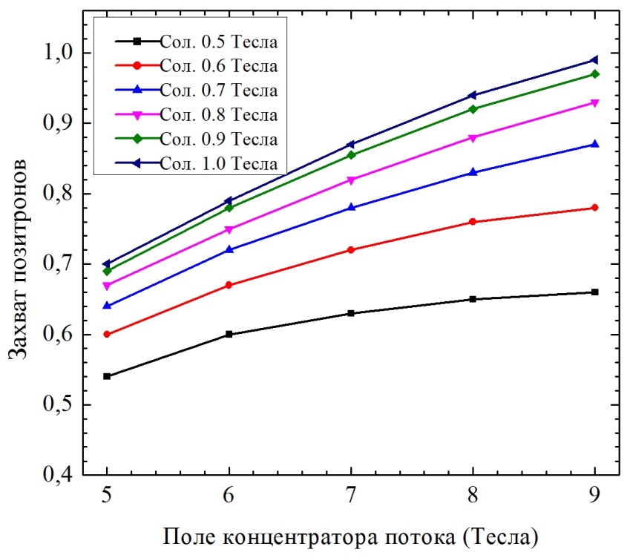
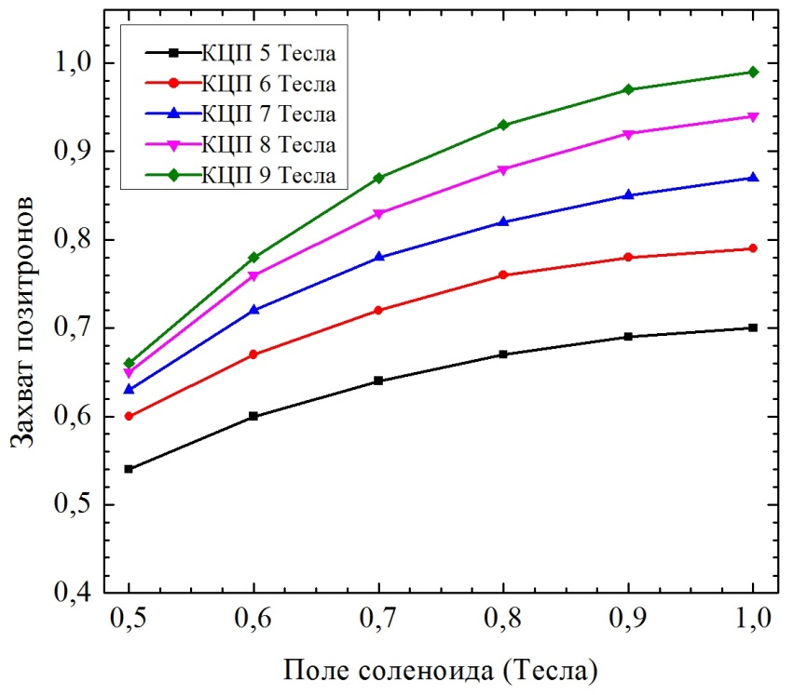
Оценочный захват позитронов ( e+ энергия ~200 MeV после соленоида)
Диаметр структуры 30мм

Slide 18
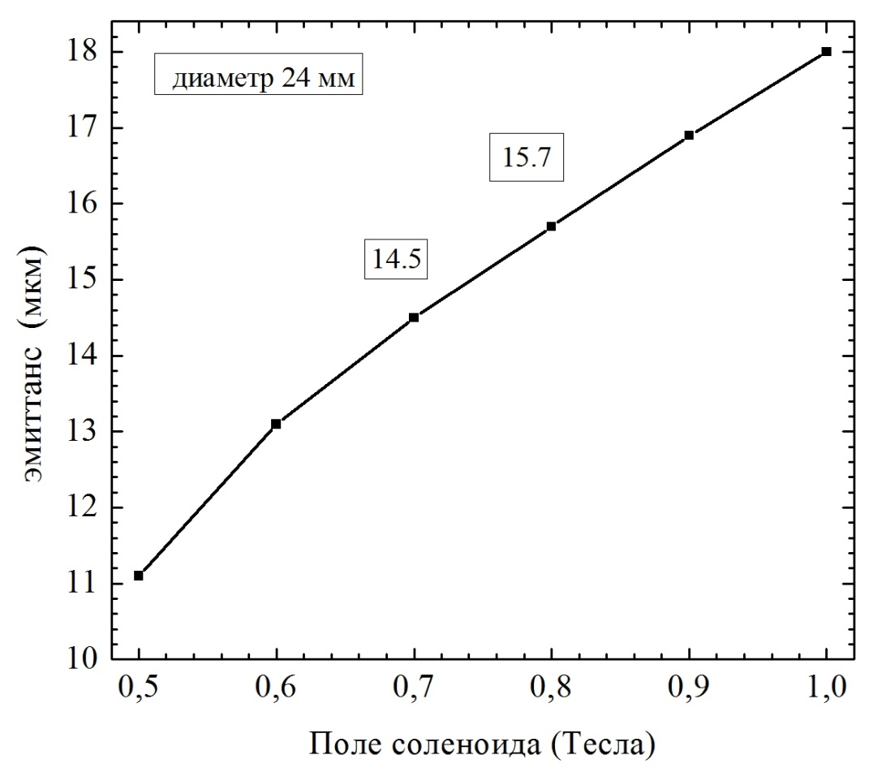
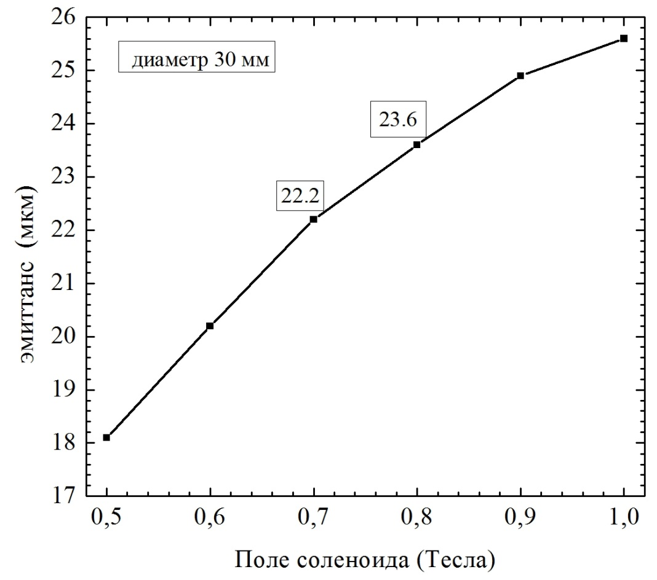
Эмиттанс позитронного сгустка ( e+ энергия ~200 MeV после соленоида)
Эмиттанс не зависит от поля концентратора потока

Slide 19
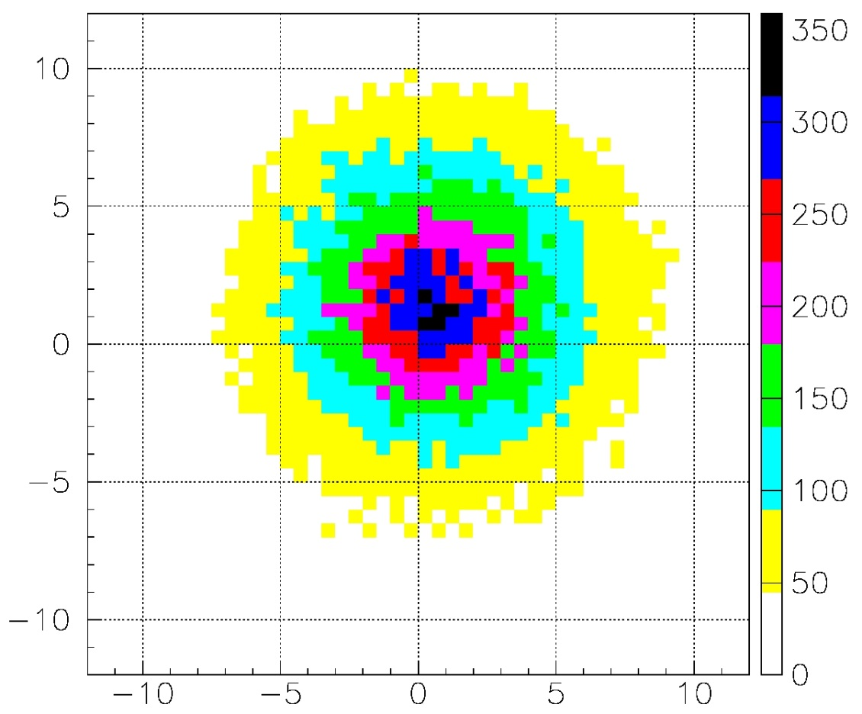
Размер позитронного сгустка (e+ энергия ~200MeV)
Поле концентратора 80 кГс
Поле соленоида 7 кГс
RMS размер ~ 4.1 mm
Горизонтальное смещение ~ 0.6 mm
Вертикальное смещение ~ 1.2 mm
Y, мм
X, мм

Slide 20
Expected positron yield (e+ energy ~200MeV)
 | FC–Solenoid field, Tesla
 | 8-0.6 |  | 8-0.7 |  | 8-0.8
Acc. Structure diameter, mm | 24 | 30 | 24 | 30 | 24 | 30
Positron yield Ne⁺/Ne⁻ | 0.6 | 0.76 | 0.69 | 0.83 | 0.76 | 0.88
Emittance, µm | 13.1 | 19.6 | 14.5 | 22.2 | 15.7 | 23.6
Vertical offset, mm | 1.1 | 1.2 | 1.2 | 1.2 | 1.1 | 1.25
Horizontal offset, mm | 0.76 | 0.7 | 0.6 | 0.8 | 0.6 | 0.7
“Safety factor” of a positron system is about 2

Slide 21
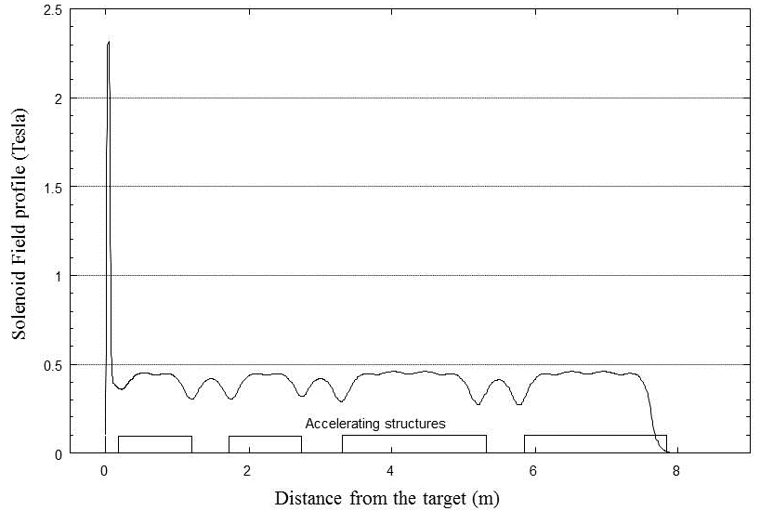

Slide 22
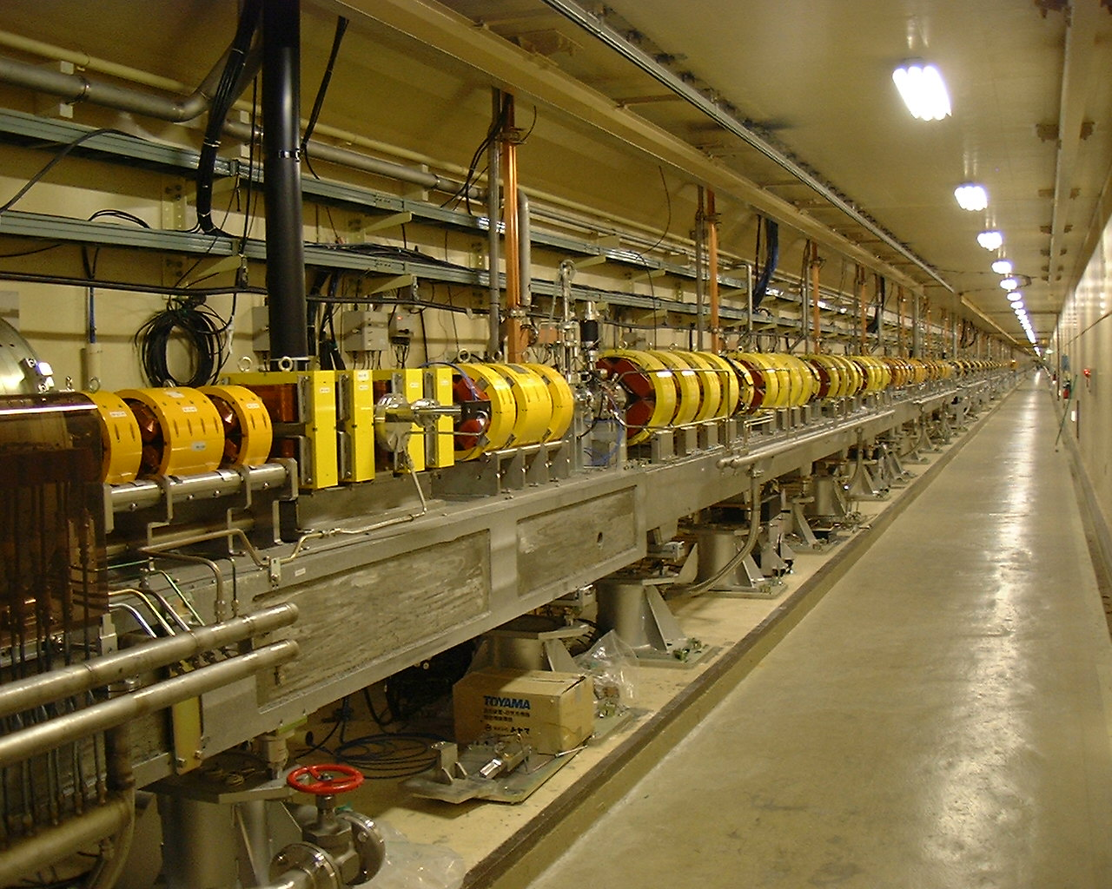
positron beam line

Slide 23
